Slide 1
CAR PRICE PREDICTION
Submitted By:- Promila Malik

Slide 2
Steps
●Overview.
●Problem Statement.
●Problem Understanding.
●What is Used Car Price Prediction?
●Importance of Used Car price prediction.
●Exploratory data analysis.
●Visualizations.
●Model Building.
●Hyper Parameter Tuning.
●Saving the model and predictions from best saved model.
●Conclusion.

Slide 3
What we analyse
●How to analyze the dataset of Used Car Price Prediction.
●What are the EDA steps in cleaning the dataset.
●Overall analysis on the problem.
●Model building from the dataset.
●Predicting Used Car Price for saved best model.

Slide 4
PROBLEM STATEMENT
With the covid 19 impact in the market, we have seen lot of changes in the car market. Now some cars are in demand hence making them costly and some are not in demand hence cheaper. One of our clients works with small traders, who sell used cars. With the change in market due to covid 19 impact, our client is facing problems with their previous car price valuation machine learning models. So, they are looking for new machine learning models from new data. We have to make car price valuation model.

Slide 5
Model Building Phase
After collecting the data, you need to build a machine learning model. Before model building do all data pre-processing steps. Try different models with different hyper parameters and select the best model.
Follow the complete life cycle of data science. Include all the steps like.
DataCleaning
ExploratoryDataAnalysis
DataPre-processing
ModelBuilding
ModelEvaluation
Selectingthebestmodel

Slide 6
EDA
●First step of the project, was scraping all the required information from cardekho.com website.
●I got 9961 rows & 11 columns after scraping the data. This data was saved in an excel file & a csv file.
●I have imported required libraries and I have imported the dataset which was in csv format.
●Then I did all the statistical analysis like checking shape, data types, nunique, value counts, info etc.
●While checking the data type, I found all the columns to be of object data type. Even our Target column : Price was of object data type.

Slide 7
Continue……..
●I then check the data types once again to see the changes in data types.
●I then, checked for null values present in the columns. I found no null values in any columns in the dataset.
●Then I checked the the statistical features of our dataset using the describe command.
●Finally, I checked if there were any empty values present in our data set. No empty values were present in the dataset.
●Next, I proceeded to do some data visualization using various Visualization techniques.

Slide 8
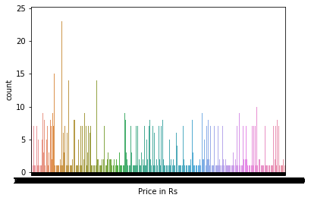
VISUALIZATIONS
Count Plot

Slide 9
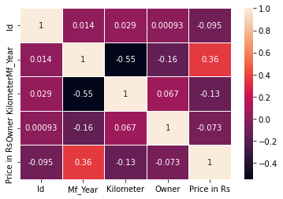
Heat Map

Slide 10
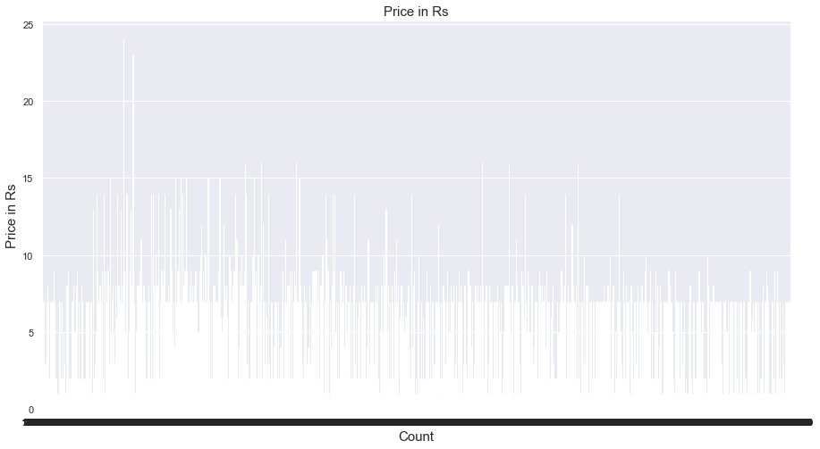
Count Plot

Slide 11
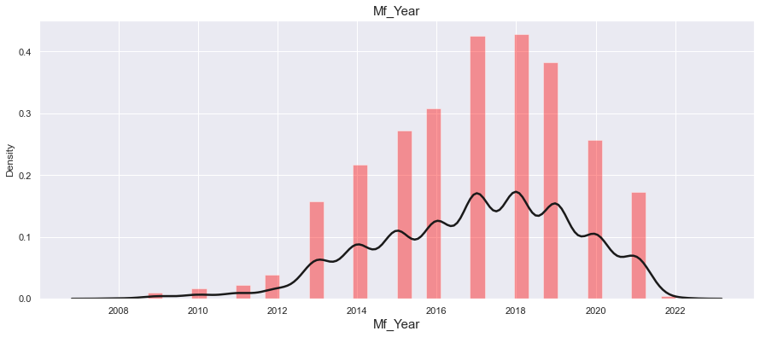
DistPlot

Slide 12
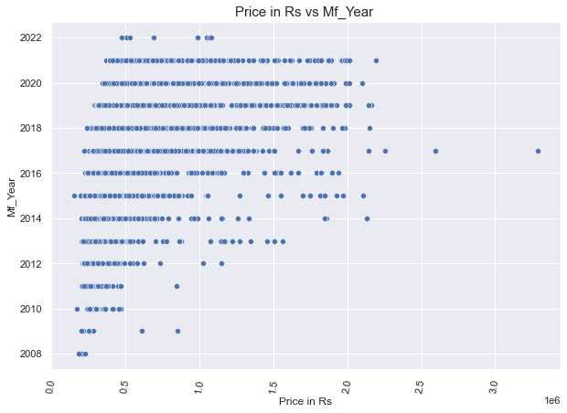
Price and Manufacturing year

Slide 13
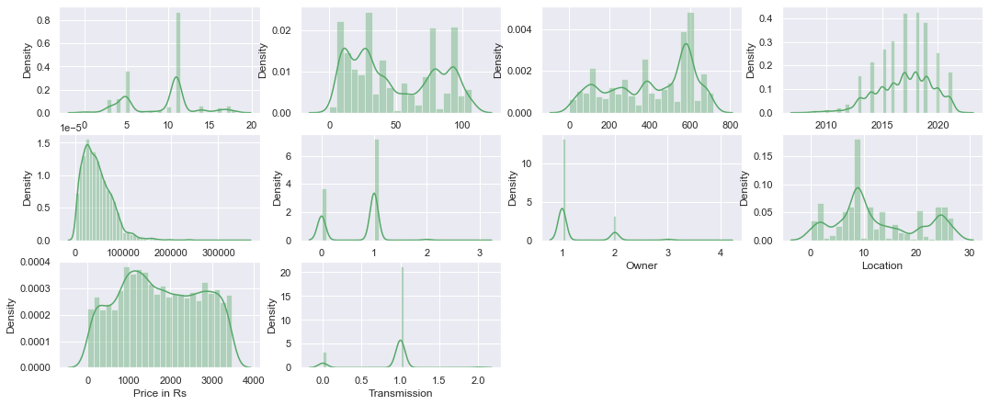
After removing Multicollinearity

Slide 14
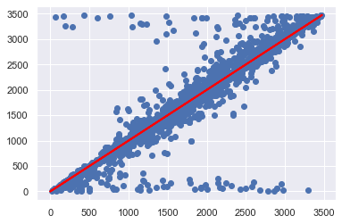
Scatter Plot

Slide 15
SAVING THE BEST MODEL
Saving the Model
In [95]:
import joblib
joblib.dump(best_rfc_grid.best_estimator_,'car price.obj')
Out[95]:
['car price.obj']
In [96]:
import pickle
filename="car price prediction.pkl "
pickle.dump(best_rfc_grid, open(filename,'wb'))
In [97]:
import numpy as np
a=np.array(y_test)
predicted= np.array(best_rfc_pred)
rf_com= pd.DataFrame({'original':a, 'predicted':predicted}, index= range(len(a)))
rf_com

Slide 16
CONCLUSION.
In this project report, we have used machine learning algorithms to predict the prices of used cars. After the completion of this project, we got an insight of how to collect data, pre-processing of the data, analyzing the data, cleaning the data and building a model.
In this study, we have used multiple machine learning models to predict the sale price of the used cars. We have gone through the data analysis by performing feature engineering, finding the relation between features and target through visualizations. And got the important features and we used these features to predict the car price by building ML models.
After training the model we checked CV score to overcome the overfitting issue. Performed hyper parameter tuning on the best model and the best model’s R2 score increased and was giving R2 score as 99.97 %. We have also got good prediction results of car prices.

